Slide 1
Employee Salary Prediction using classification algorithm’s
IBM PROJECT’S
Presented By :
Name: Namneet Dash College: Trident Academy of Technology Department: Computer Science and Engineering AICTE Internship Student Regd ID: STU665ae065302cc1717231717

Slide 2
OUTLINE
Problem Statement
System Development Approach
Algorithm & Deployment
Result
Project Workflow
Conclusion
Future Scope
References

Slide 3
Problem Statement
Determining fair and accurate employee salaries is a complex challenge faced by organizations across various sectors. Salaries depend on multiple factors such as age, education, occupation, working hours, and years of experience. Inconsistent salary structures can lead to dissatisfaction, imbalance, and inefficiencies in workforce management. There is a growing need to analyze employee-related data to understand patterns and predict salary trends more effectively. Identifying the key attributes that influence employee earnings is essential for ensuring transparency and equity in compensation.

Slide 4
System Approach
✅ System Requirements
Operating System: Windows 10 / Linux / macOS
Processor: Intel Core i3 or higher
RAM: Minimum 4 GB (8 GB recommended)
Software: Python 3.8 or above, Streamlit, and a web browser
Storage: At least 500 MB of free space for libraries, data, and model files
✅ Libraries Required to Build the Model
Pandas – for data manipulation and analysis
Joblib – for saving and loading the trained model
Scikit-learn – for building and training machine learning models
Streamlit – for creating the interactive web application
NumPy – for numerical operations (if used during preprocessing/modeling)

Slide 5
Algorithm & Deployment
🔹 1. Data Collection
Dataset used: adult 3.csv (UCI Adult Income Dataset variant)
Loaded using pandas.read_csv() for analysis and preprocessing.
Initial insights gathered using:
data.head() and data.tail() – to preview entries.
data.shape – to understand dataset dimensions.
🔹 2. Handling Missing Values
Identified missing values represented by '?' in workclass and occupation.
Replaced '?' with "Others" using replace() to maintain data integrity.
Ensured no NaN values using data.isna().sum() for all columns.
🔹 3. Irrelevant Data Removal
Removed rows where workclass values were:
'Without-pay'
'Never-worked'
This helped maintain relevant workforce data for salary prediction

Slide 6
Algorithm & Deployment
🔹 4. Outlier Detection & Removal
Used matplotlib.pyplot.boxplot() for visualizing outliers in:
age, educational-num, capital-gain, hours-per-week
Applied filtering conditions to remove extreme values:
age filtered between 17 and 75
educational-num restricted between 5 and 16
Ensured data consistency and reduced noise for better model performance.
🔹 5. Feature Selection & Transformation
Dropped the education column due to high correlation with educational-num.
Used Label Encoding on categorical variables:
workclass, marital-status, occupation, relationship, race, gender, native-country
Label Encoding enabled machine learning models to process categorical data.

Slide 7
Algorithm & Deployment
🔹 6. Data Splitting
Divided data into:
Training set (80%)
Testing set (20%)
Used train_test_split() from sklearn.model_selection with a fixed random_state for reproducibility.
🔹 7. Model Selection
Chose five popular machine learning models:
Logistic Regression
Random Forest
K-Nearest Neighbors (KNN)
Support Vector Machine (SVM)
Gradient Boosting Classifier
🔹 8. Pipeline Creation
Used Pipeline from sklearn.pipeline for each model:
Included StandardScaler for feature scaling.
Combined preprocessing and model into a single pipeline.

Slide 8
Algorithm & Deployment
🔹 9. Model Training & Prediction
Trained all models using training data: X_train, y_train.
Used pipeline.fit() for training, and pipeline.predict() for predictions.
🔹 10. Performance Evaluation
Evaluated model performance using:
accuracy_score() – to measure correct predictions
classification_report() – to analyze precision, recall, F1-score
🔹 11. Best Model Selection
Compared model results and selected the one with:
Highest accuracy on test set
Balanced precision and recall
Saved the best model using joblib.dump() for deployment in Streamlit app.

Slide 9
Algorithm & Deployment
🔹 12. Web Application Using Streamlit
Developed a web app using the Streamlit framework.
Features:
Sidebar inputs: age, education, occupation, hours/week, experience
Real-time prediction using loaded model
Display of prediction result in a success box
🔹 13. Batch Prediction Module
Allowed users to upload a .csv file with employee data
Predicted salary class for all rows and displayed output table
Enabled download of prediction results as a CSV file
🔹 14. Deployment & Accessibility
Deployed Streamlit app for local use and prepared for cloud deployment .
Created a smooth, user-friendly interface to make predictions accessible for both technical and non-technical users.

Slide 10
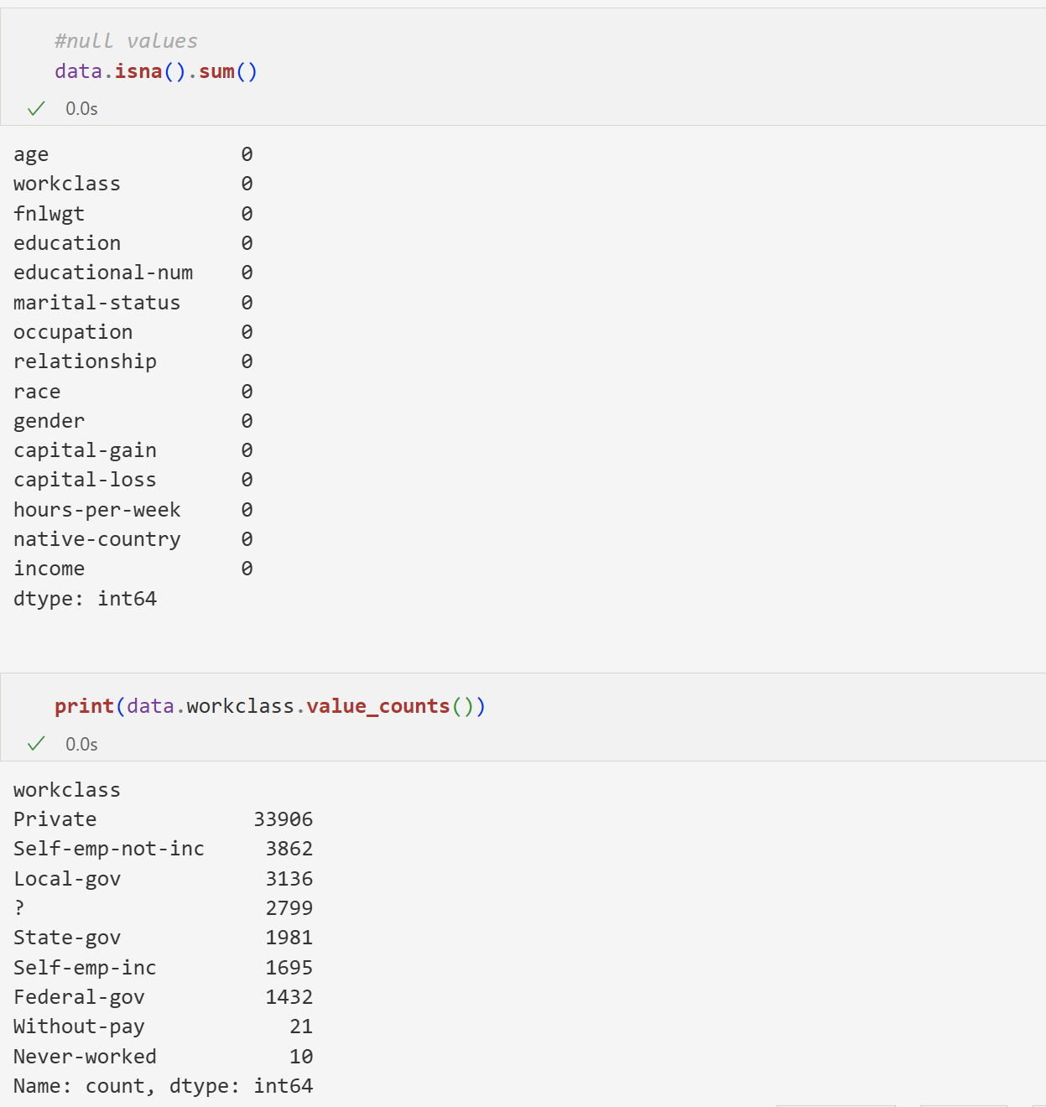
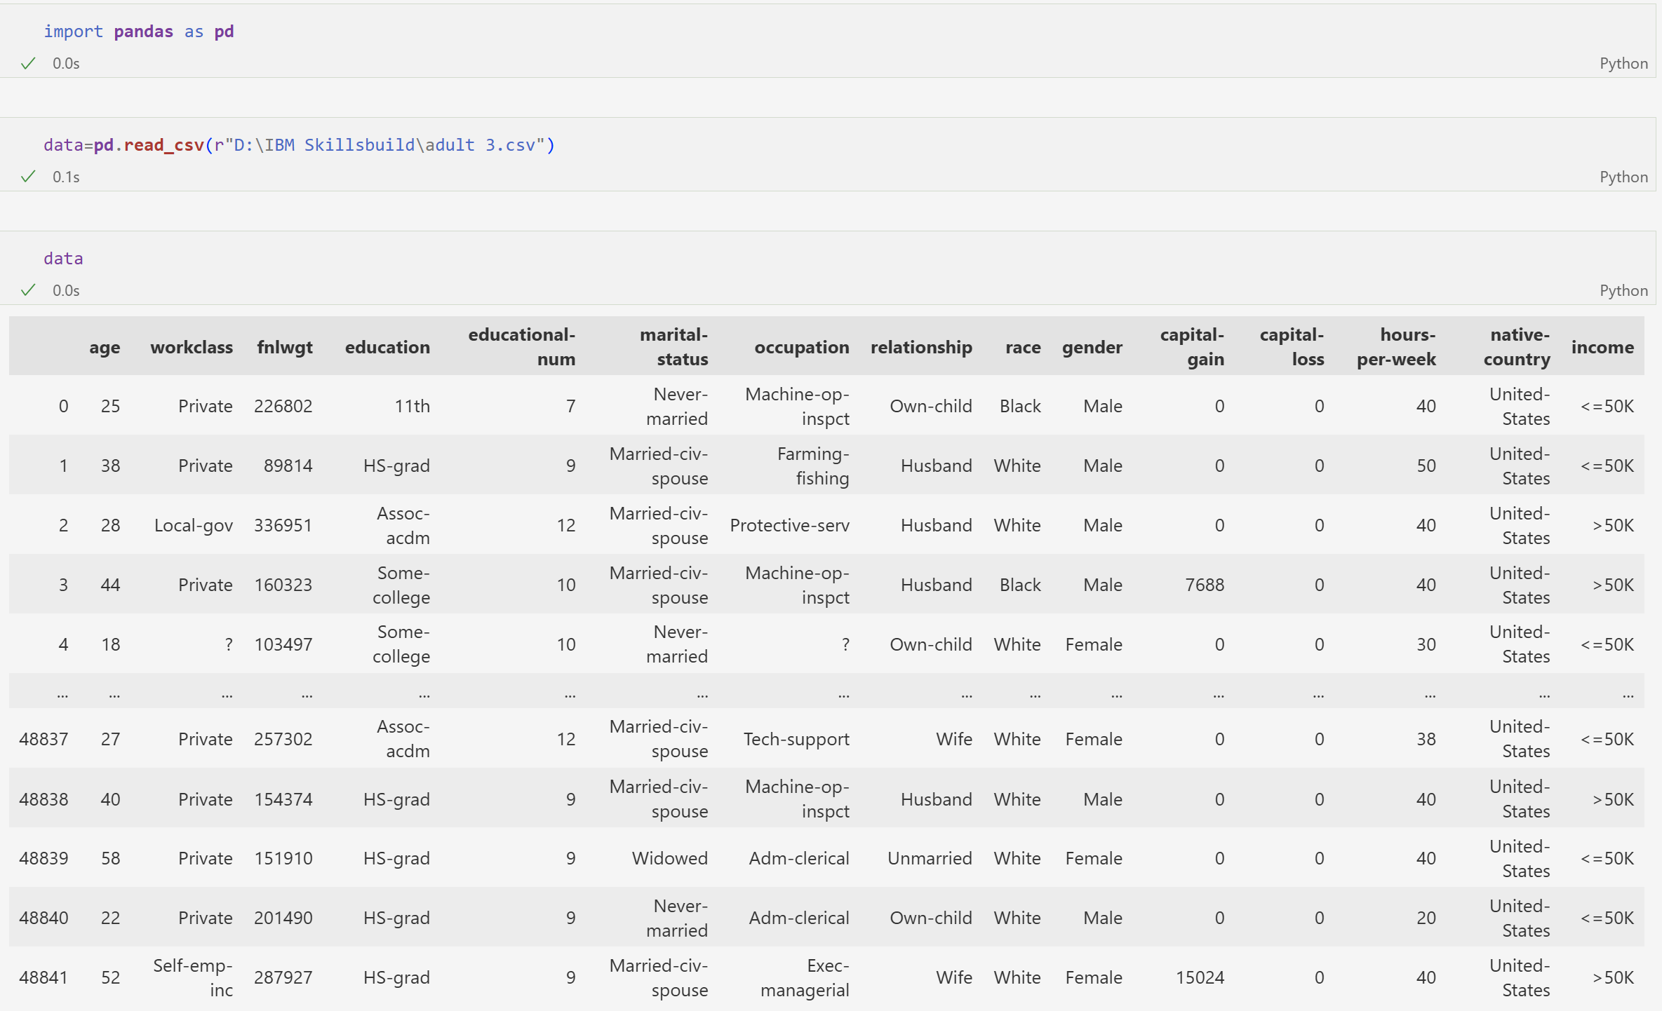
Result :

Slide 11
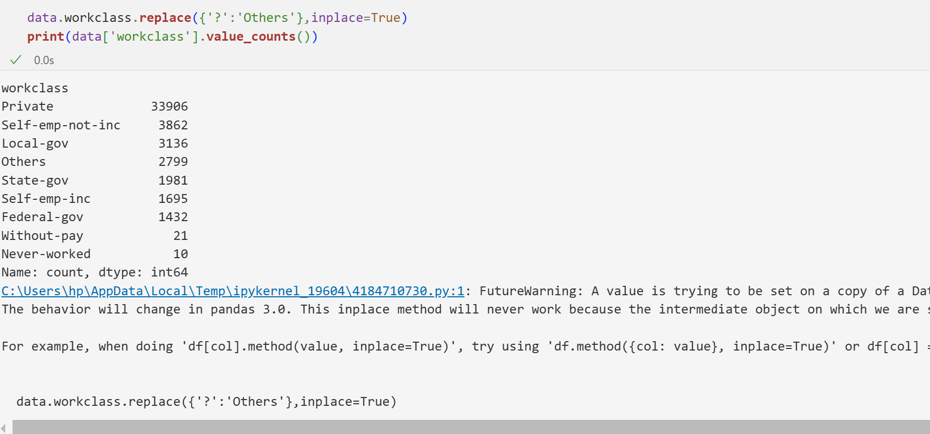
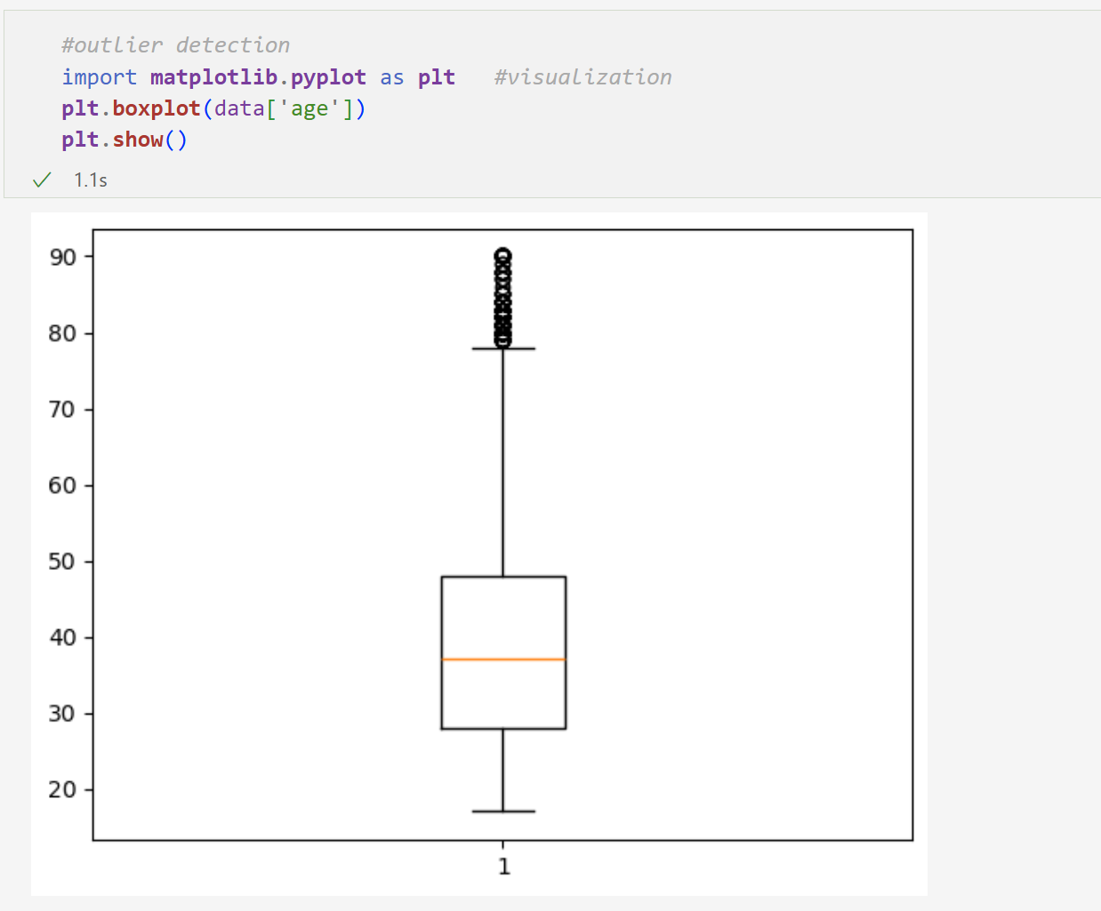

Slide 12
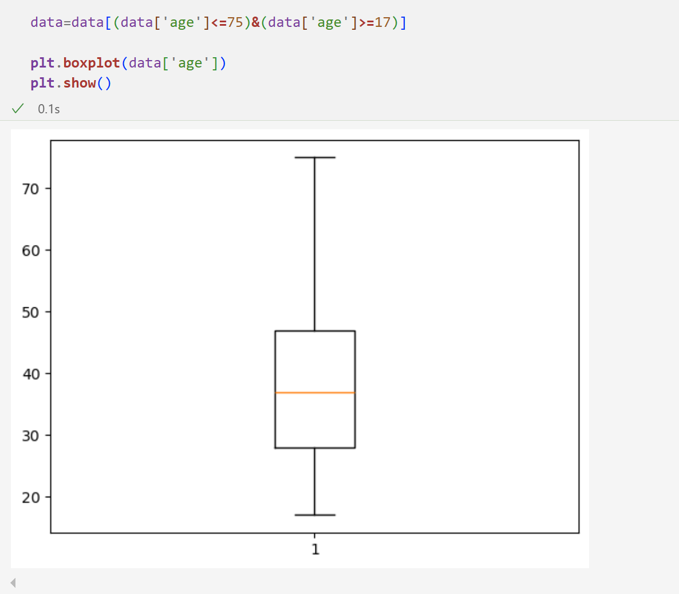
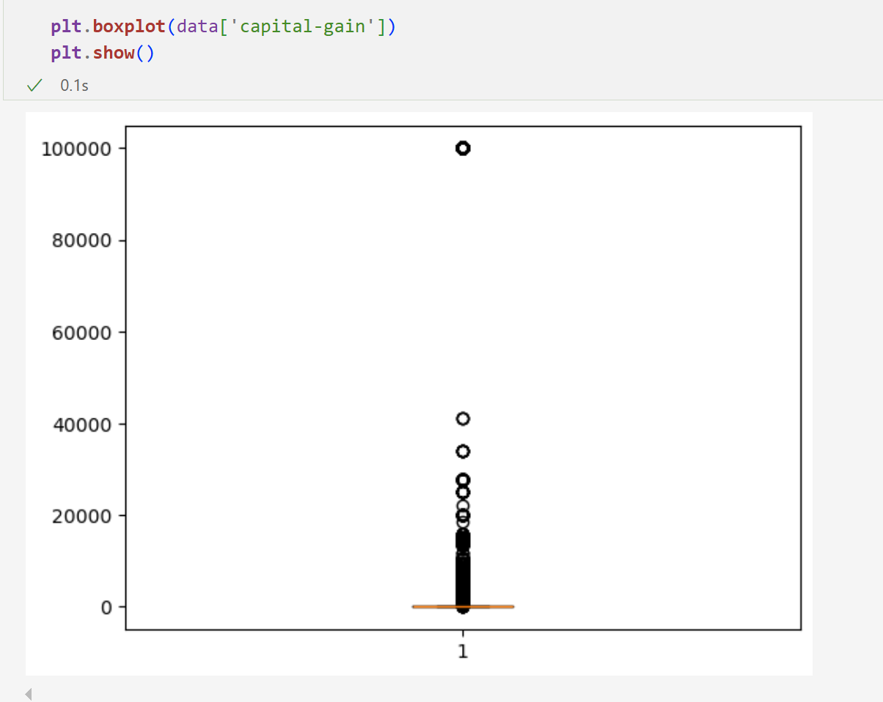

Slide 13
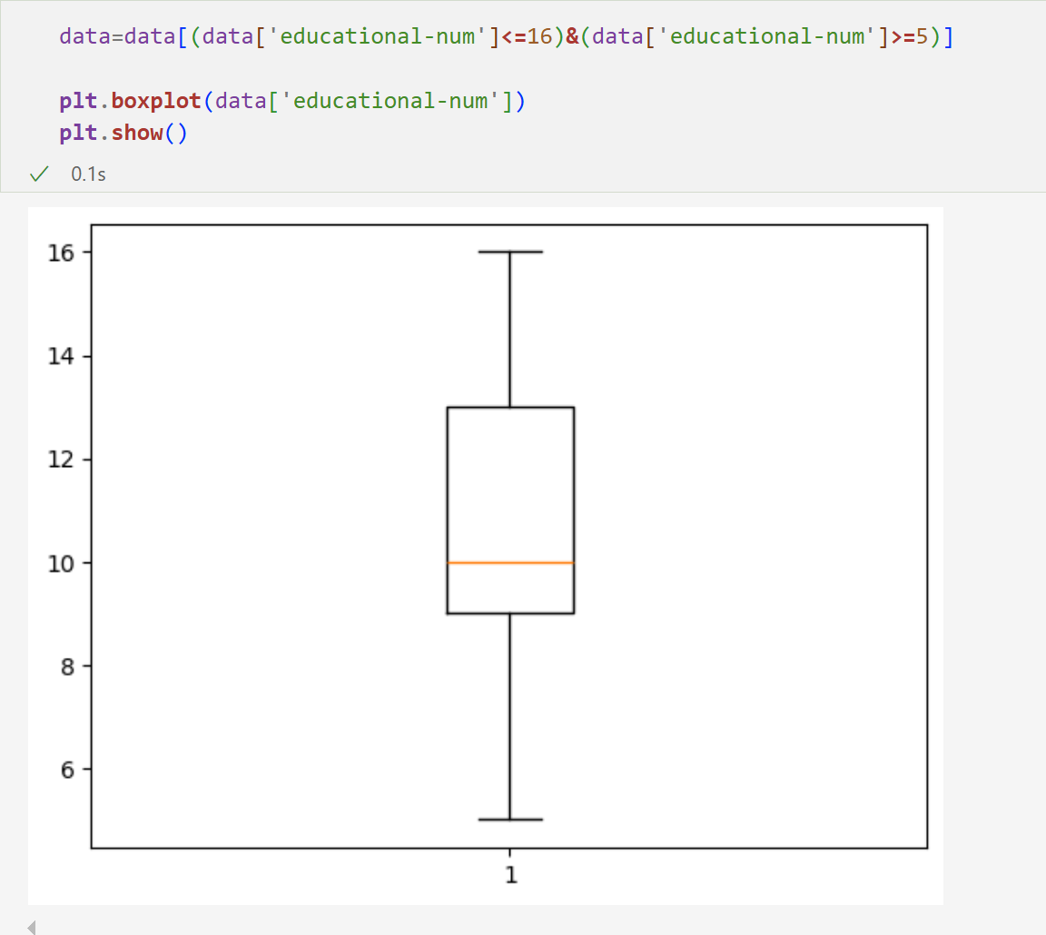
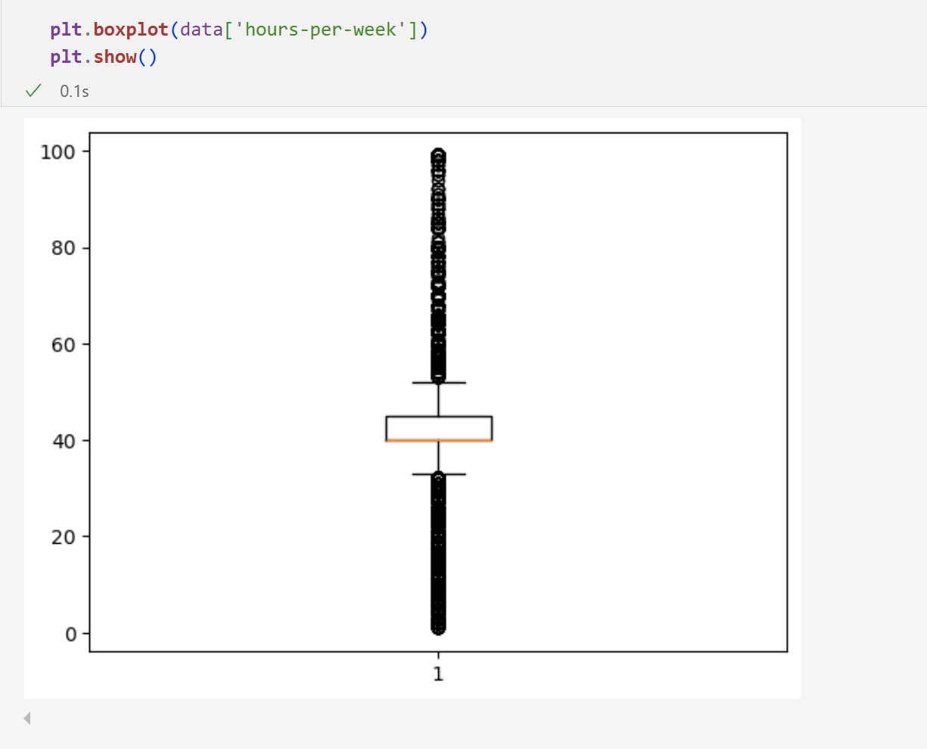

Slide 14
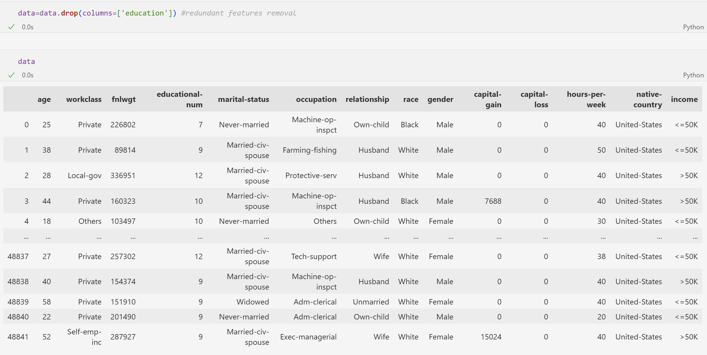
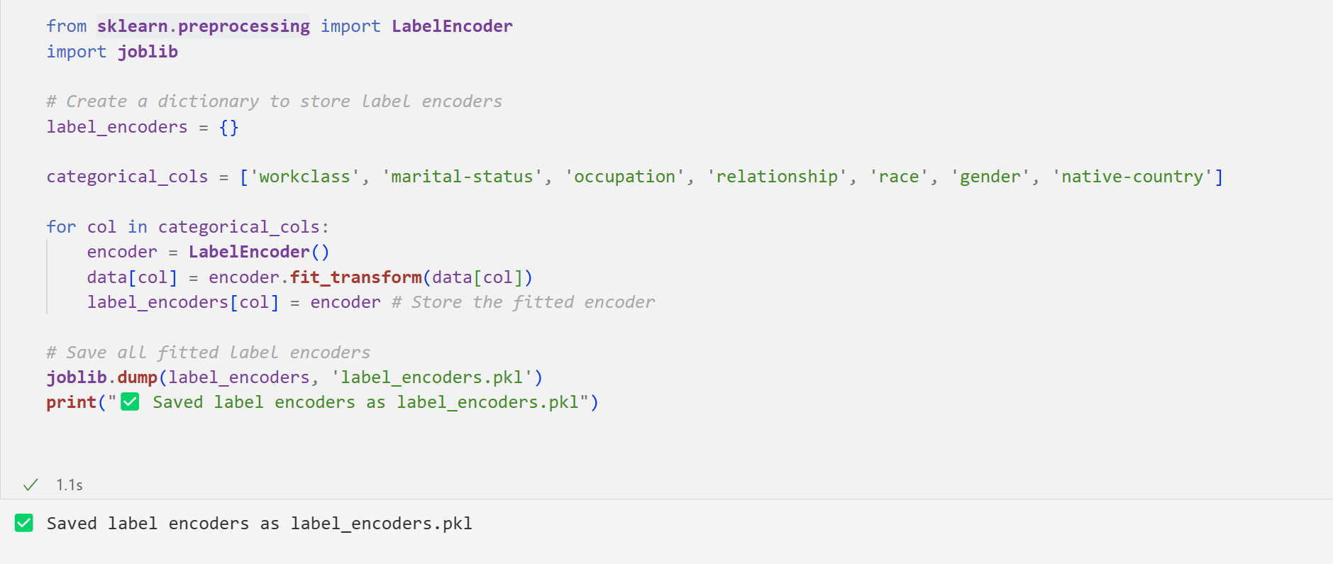

Slide 15
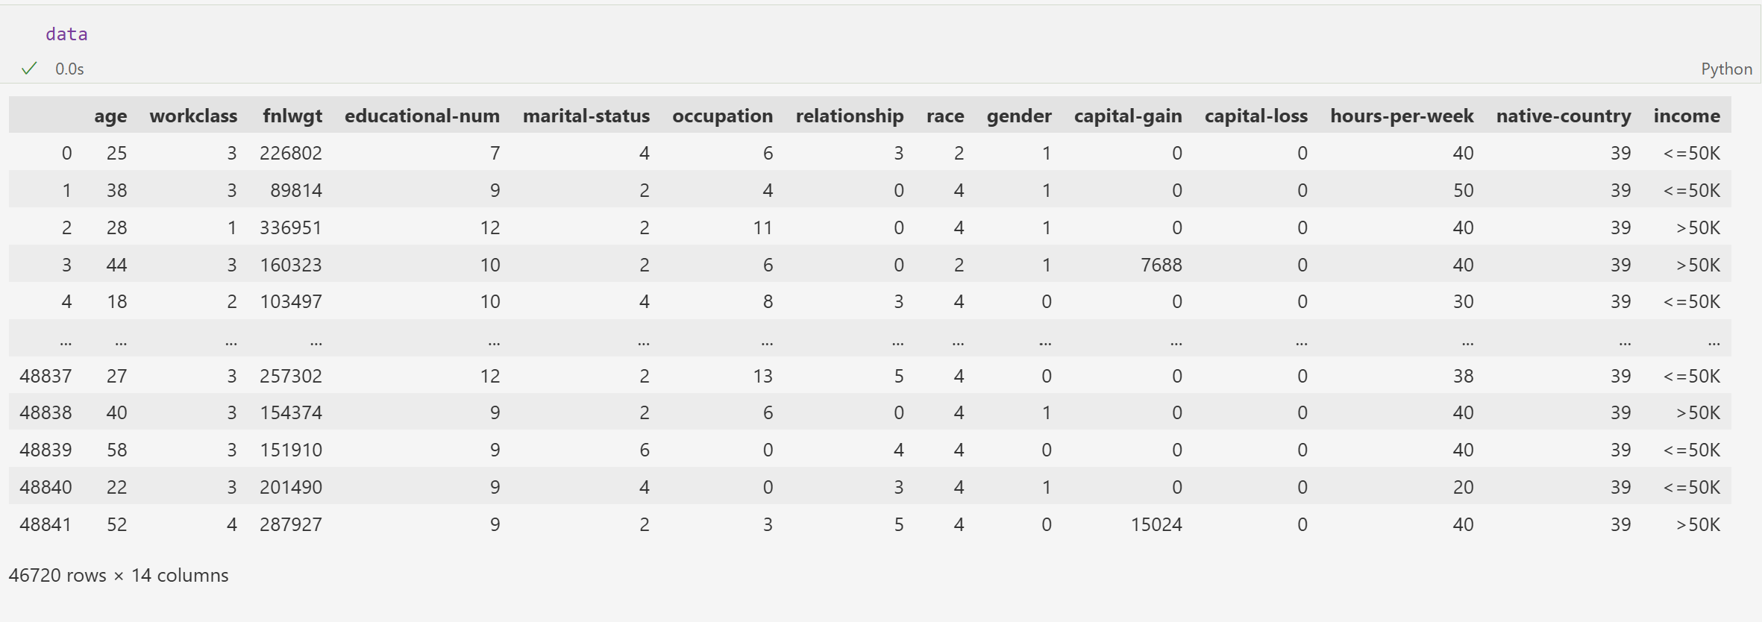
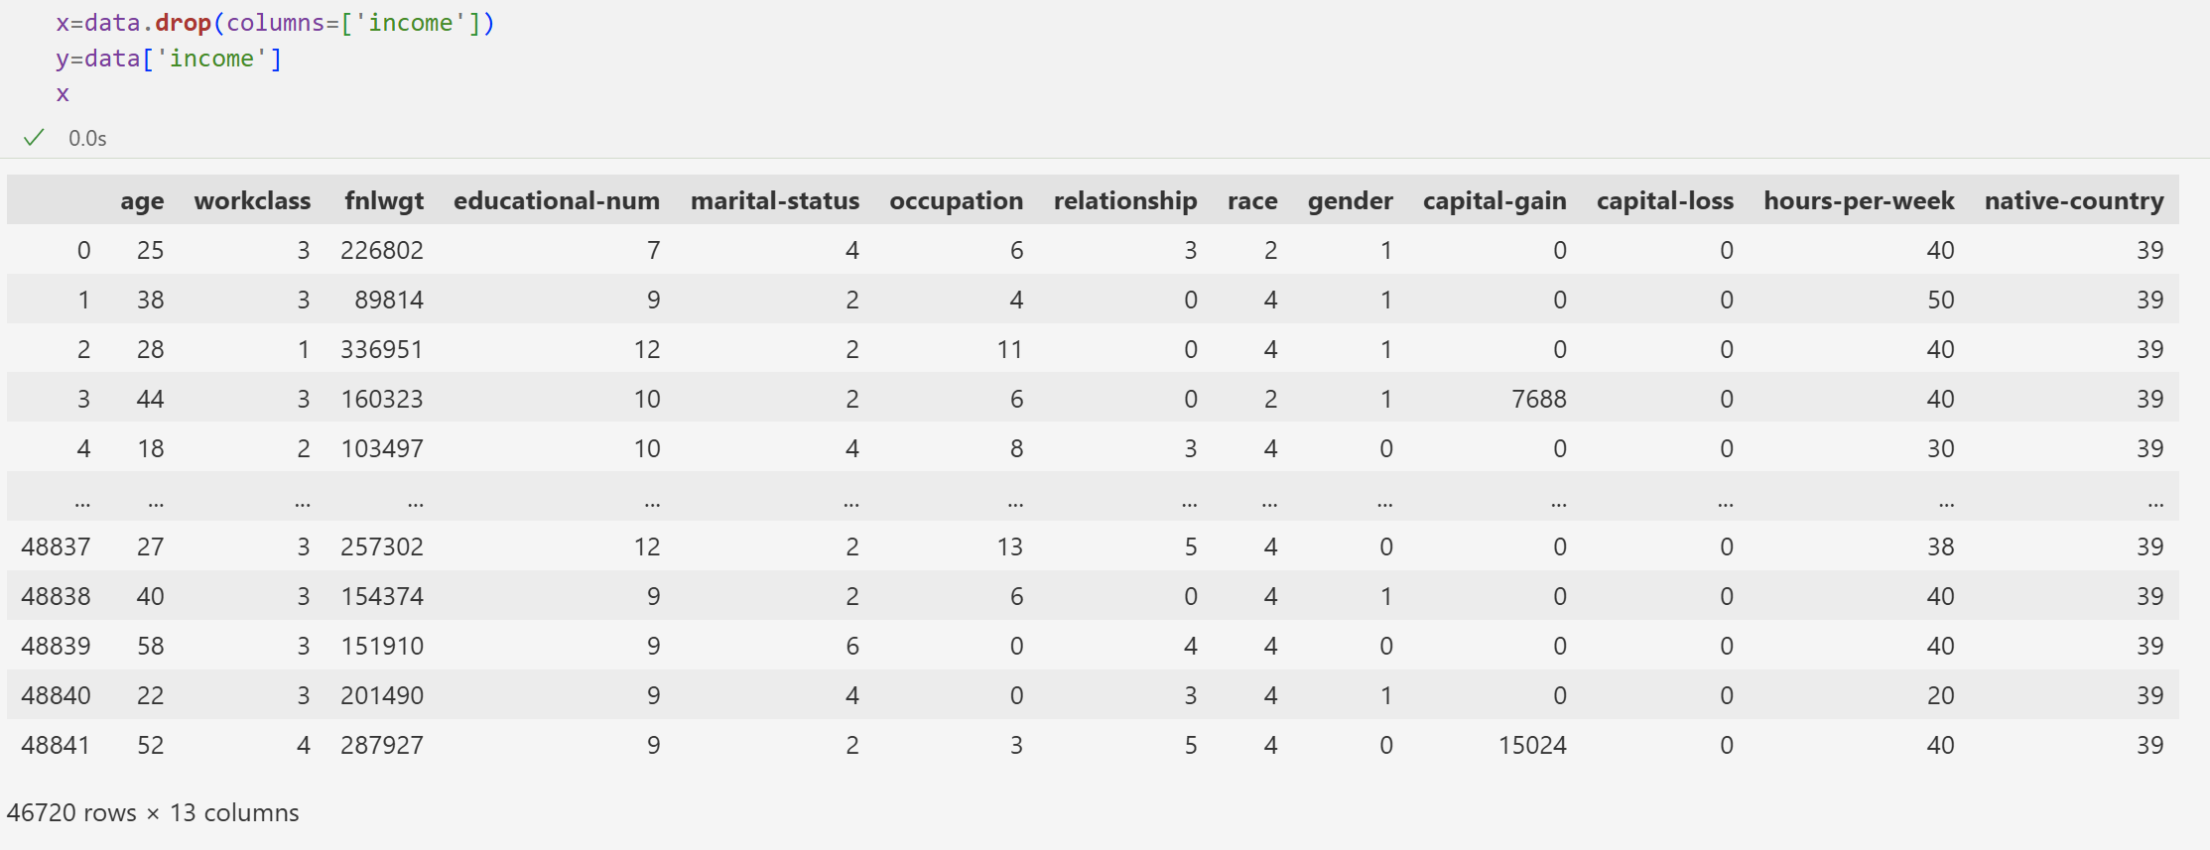

Slide 16
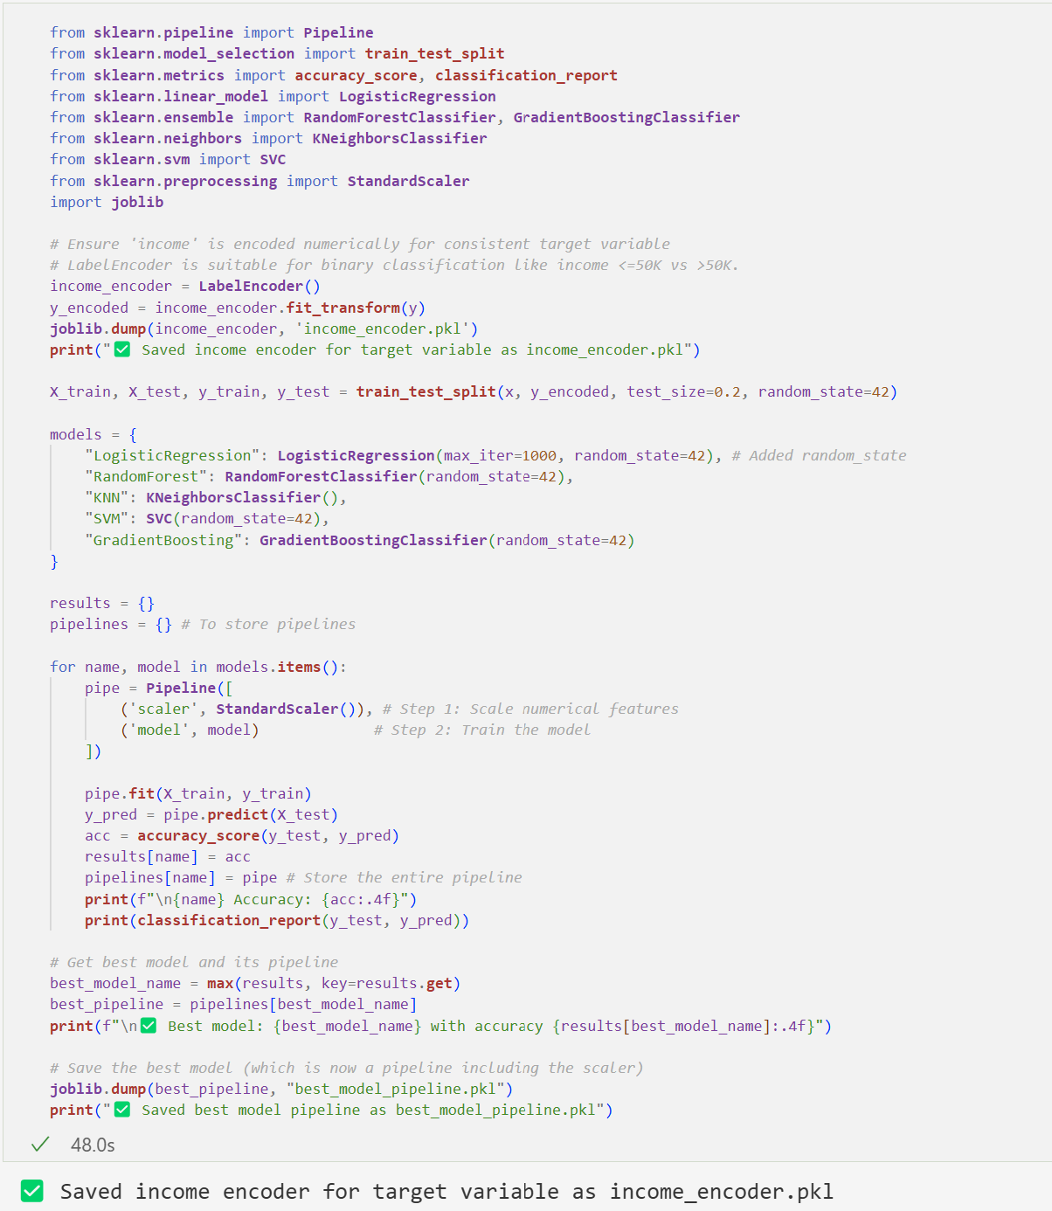
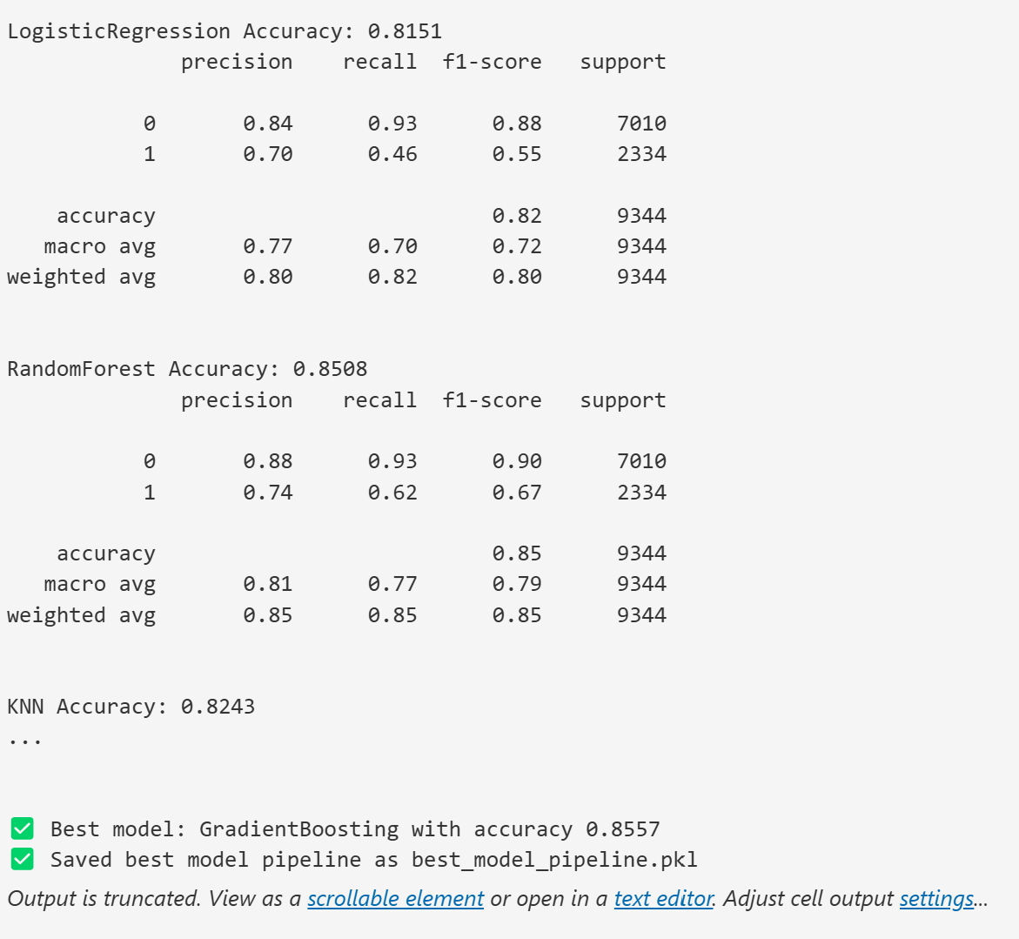

Slide 17
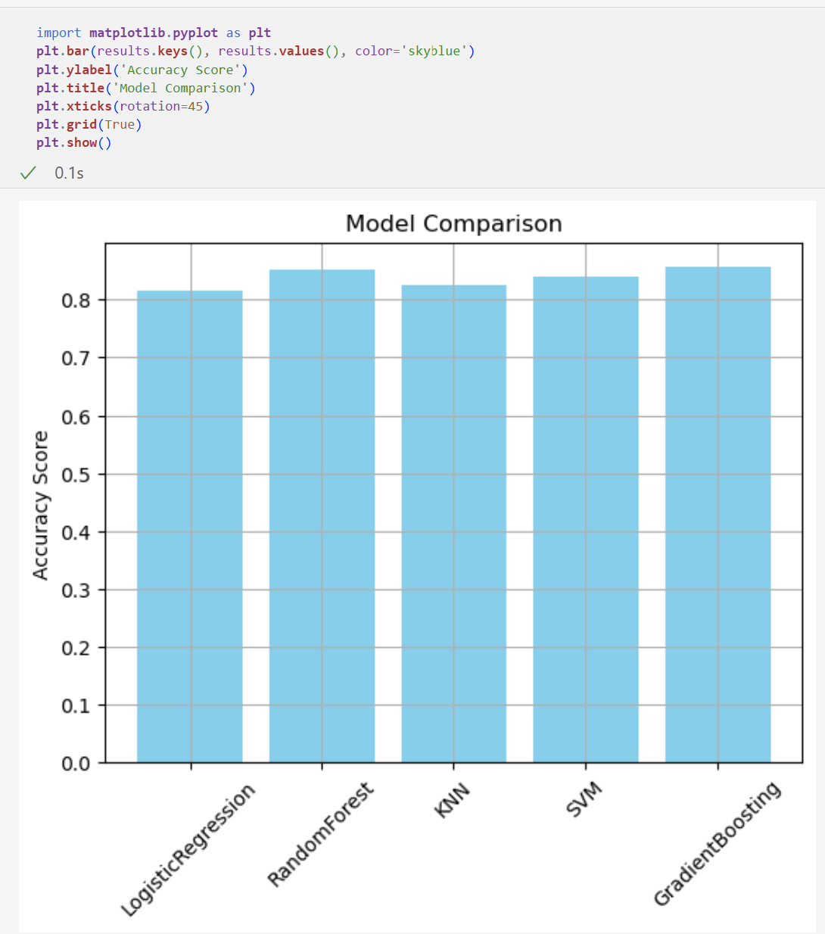

Slide 18
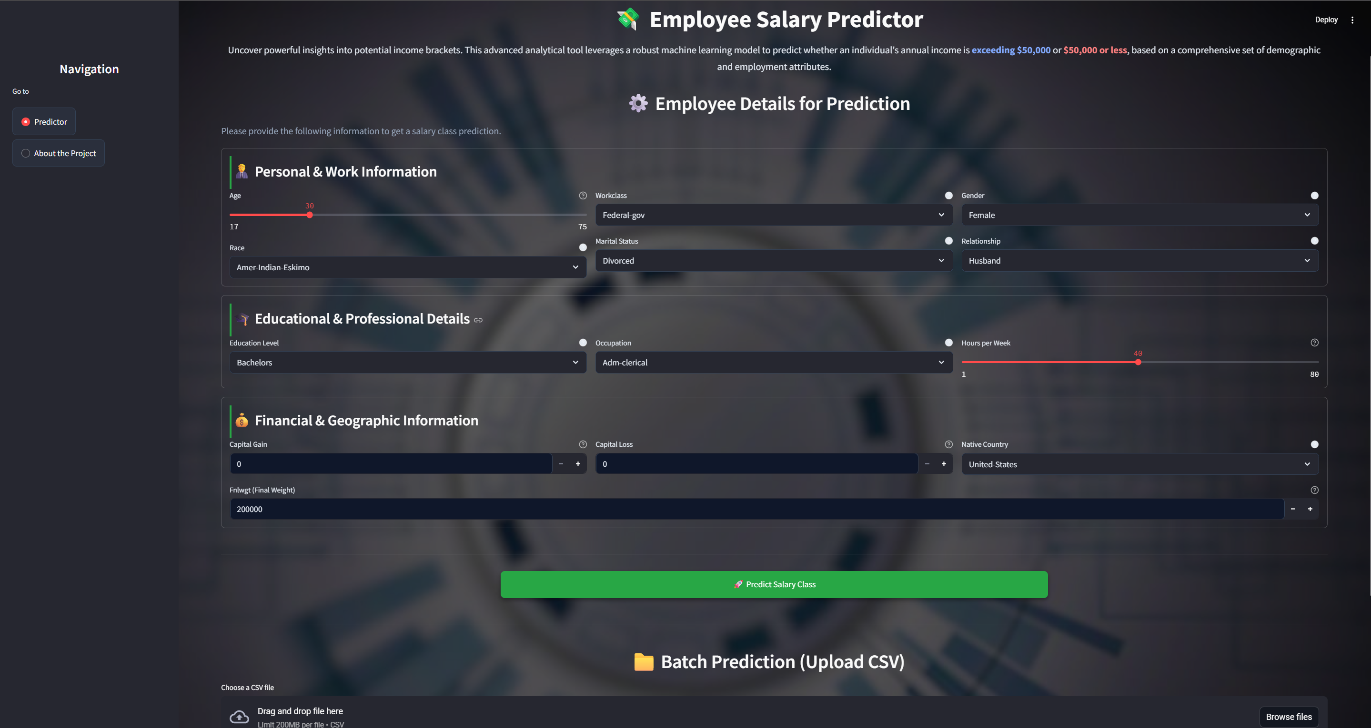
Project Workflow

Slide 19
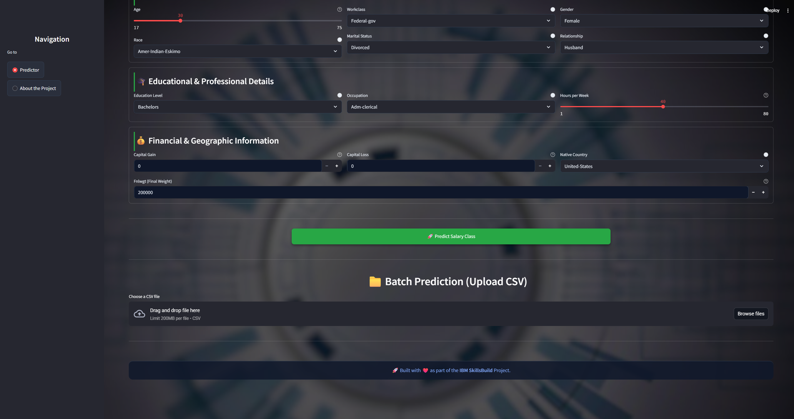

Slide 20
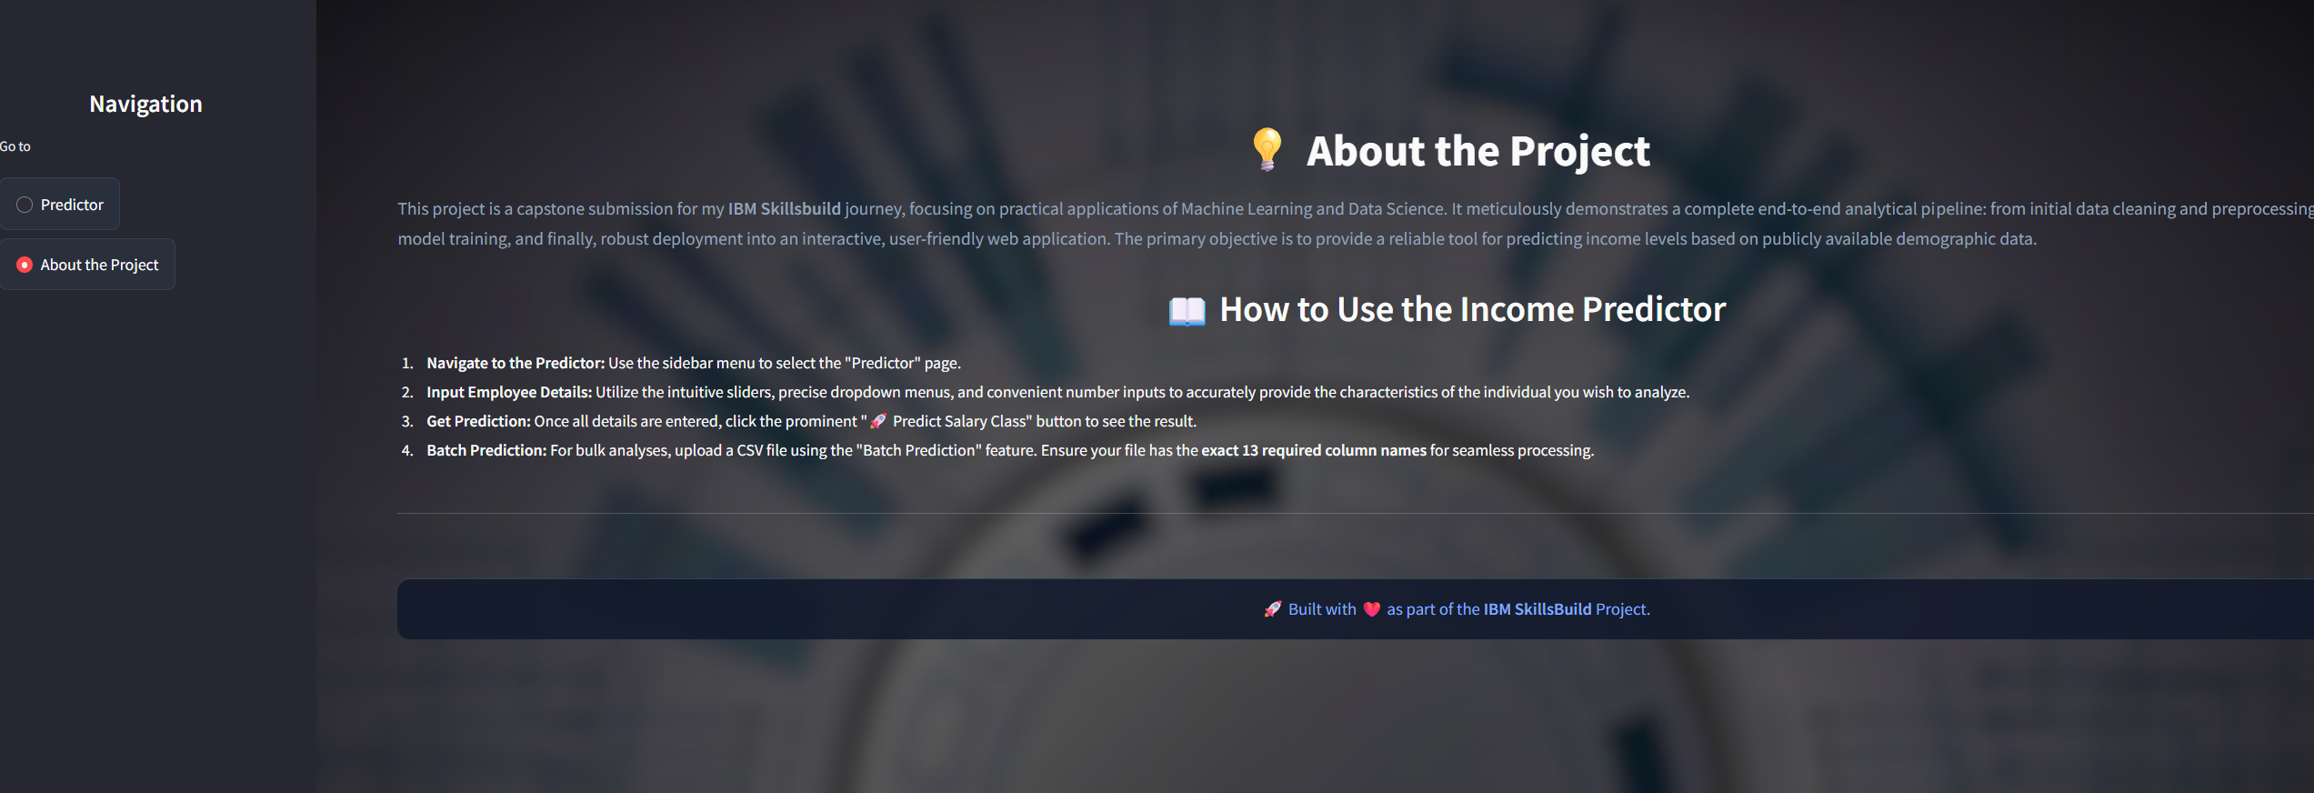

Slide 21
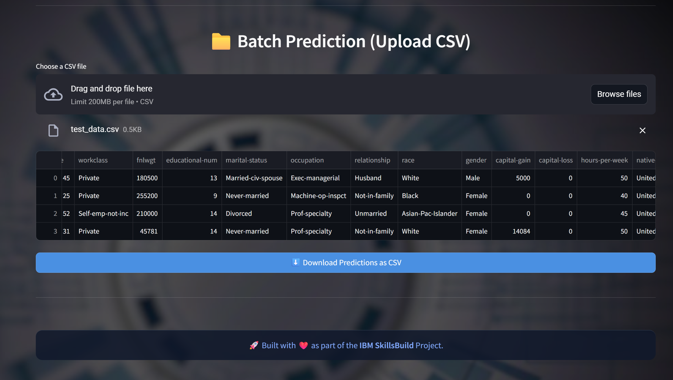
For complete code,datasets and documentation,
Please visit my GitHub repository:
https://github.com/code2104-sys/Employee_Salary_Predictor.git

Slide 22
Conclusion
The project demonstrates a complete machine learning workflow—from data preprocessing to model deployment.
Various regression algorithms were explored and evaluated to predict employee salaries effectively.
Data cleaning, encoding, and outlier handling ensured that the model was trained on high-quality data.
The integration of a user-friendly Streamlit interface enables real-time and batch salary predictions.
This system highlights the role of data-driven approaches in assisting HR and organizational decision-making.
The predictive model can serve as a foundation for future enhancements in salary forecasting systems.

Slide 23
future scope
Real-Time Data Integration In the future, the system can be enhanced by integrating with real-time HR management tools. This will allow the model to continuously learn and adapt from live employee data, improving accuracy and relevance over time.
Advanced Model Enhancement Beyond linear regression, future iterations can leverage advanced machine learning techniques like Random Forest, Gradient Boosting, and Deep Neural Networks. Additionally, incorporating techniques like Grid Search and Cross-Validation will optimize model performance.
Expanded Feature Set Including more predictive features such as job location, industry sector, company size, work performance scores, and current market salary benchmarks can make the model more robust and context-aware.
Cross-Platform & Multilingual Accessibility The Streamlit application can be further extended to mobile platforms (Android/iOS) and support multiple languages, making it accessible to HR teams and users across different regions and languages.
Cloud Deployment & API Access Future deployment using cloud platforms like AWS, Azure, or Google Cloud can provide scalable infrastructure. Secure RESTful APIs can allow other systems or web apps to access the model as a service, ensuring scalability and wider integration.

Slide 24
references
Scikit-Learn – Machine learning library used for implementing the Linear Regression model and evaluating metrics like R² score. 🔗 https://scikit-learn.org
Pandas – Used for data loading, preprocessing, and manipulation (e.g., handling CSV files and feature selection). 🔗 https://pandas.pydata.org
NumPy – Provided numerical computation support for array operations and model input formatting. 🔗 https://numpy.org
Matplotlib & Seaborn – Utilized for exploratory data analysis and plotting feature correlations and trends. 🔗 https://matplotlib.org 🔗 https://seaborn.pydata.org
Streamlit – Used to build and deploy the interactive web app for real-time salary prediction. 🔗 https://streamlit.io

Slide 25
THANK YOU

